Slide 1







HT only: Ionic Equations and Displacement Reactions
Read Now
Sunday 30 November 2025
Ionic Equations and Displacement Reactions
Task:
Complete the Read Now by:
Stick in the sheet.
Using a highlighter as you read to identify key terms.
Answer the first four recall questions under the sheet in your book.
Answer the stretch question
HT only: Ionic Equations and Displacement Reactions
HT only: Ionic Equations and Displacement Reactions
Aim High | Work Together | Be Kind | Lead the Way

Slide 2

Read Now
Aim High | Work Together | Be Kind | Lead the Way
Aim High | Work Together | Be Kind | Lead the Way

Slide 3
Read Now
MARK SCHEME:
1. An ion is a charged atom or molecule.
2. A displacement reaction occurs when one ion replaces another in a compound.
3. One component of an ionic equation is an ion.
4. It means to separate the soluble salts into their ions.
5. The ionic equation is Na⁺ + Cl⁻ + Ag⁺ + NO₃⁻ → AgCl + Na⁺ + NO₃⁻.
Aim High | Work Together | Be Kind | Lead the Way
Aim High | Work Together | Be Kind | Lead the Way

Slide 4
Daily Review
Follow your teachers instructions:
“When I say go show me a MWB and a MWB Pen”
You will have 10 seconds for each question.
Hold your MWB in the Ready position
“Show me”
You need to score 70% to pass
Subtitle ‘test score’ ?/10
Aim High | Work Together | Be Kind | Lead the Way
Notes:
Teachers remember to input the quiz score

Slide 5
Objectives
Following this lesson, students will be able to:
• Write chemical equations in terms of ions
• Write ionic equations for displacement reactions
• Identify oxidised and reduced species using ionic equations
Lesson 1
Lesson 2
Lesson 3
Lesson 4
Lesson 5
Lesson 6
Lesson 8
Lesson 9
Lesson 10
Lesson 7
Aim High | Work Together | Be Kind | Lead the Way
Notes:
11.2 5.19

Slide 6

Exposition
Key Words:
spectator ions
oxidation
displacement
reduction
Aim High | Work Together | Be Kind | Lead the Way
Notes:
11.31 1.42
11.2 4.35

Slide 7
(a) Identify the ions present in each of these formulae
(b) State how many of each ion is in the formula
NaCl
HCl
Li₂O
4. H₂SO₄
5. Cu(NO₃)₂
1
1
1
2
H⁺ SO₄²⁻
Na⁺ Cl⁻
1
1
H⁺ Cl⁻
1
2
Cu²⁺ NO₃⁻
2
1
Li⁺ O²⁻
(c) Complete the table below.
A | B | Would A need to gain or lose electrons to become B? | How many electrons?
H_{(g)} | H⁺_{(aq)}
Na⁺_{(aq)} | Na_{(s)}
Cl_{2(g)} | 2Cl⁻_{(aq)}
Cu²⁺_{(aq)} | Cu_{(s)}
Mg_{(s)} | Mg²⁺_{(aq)}
lose
1
gain
1
gain
2
gain
2
lose
2
Notes:
Exposition type: Explanation
Students should be secure in answering these questions to be able to access the learning from the rest of this lesson.
Model teacher exposition:
Firstly, I want you to identify the ions that are present in these formulae. You do not need to know ion formulae off by heart – use the list of ions you have been provided.
Do one example on the board first, narrating your thought process out loud.
Next we will write down how many of each ion is needed to make the formula. If there is a subscript number that is in addition to the usual ion formula, that indicates that there is more than one of any type of ion.
So, for K₂O, I know the ions in here are K⁺, another K⁺ and O²⁻
Think back to our lesson on ionic bonding. Why are there 2 potassium ions and only one oxygen ion in this example? Because two potassium ions are needed to neutralise (or cancel out) the oxide ion, which has a charge of 2-.
Looking at the table, I want you to remember that an electron has a negative charge.
So, if a neutral atom (neutral means no charge) gains electrons, it is gaining negative charges, and so it will end up being negatively charged.
It might help to draw the electronic configurations of these ions and imagine electrons being gained or lost, and the resulting charges.

Slide 8
Writing ionic equations
Use your list of ions handout to help!
Look at this chemical equation:
Mg_{(s)} + CuSO_{4(aq)} → MgSO_{4(aq)} + Cu_{(s)}
We can use 2 steps to write this as an ionic equation:
Step 1: Split up the aqueous (aq) substances into their ions
Mg_{(s)} + Cu²⁺_{(aq)} + SO₄²⁻_{(aq)} → Mg²⁺_{(aq)} + SO₄²⁻_{(aq)} + Cu_{(s)}
Step 2: Delete the spectator ions (the ones that appear on both sides)
Mg_{(s)} + Cu²⁺_{(aq)} → Mg²⁺_{(aq)} + Cu_{(s)}
Notes:
Exposition type: Explanation
Model teacher exposition:
We are going to look at how to write ionic equations. These equations will become increasingly important as we work through this unit, so we want to ensure you are secure in writing these.
We can start with a regular chemical equation.
Just like we did earlier in the lesson, let’s first break up any of the aqueous substances into their ions – that’s step 1.
Use the list of ions that you have been provided to check the charges on each ion carefully, and make sure the state symbols are written.
When we break up an aqueous substance into its ions, each of those will also be aqueous, so just keep the same state symbol.
Now, look on each side of the equation (each side of the arrow).
Are there any species that are exactly the same on each side? Yes
These are called the spectator ions, and we don’t want these in our final equation. So I’m going to rewrite the equation without these.
Our final result is an ionic equation.

Slide 9
What does an ionic equation show?
Mg_{(s)}
+ Cu²⁺_{(aq)}
→
Mg²⁺_{(aq)}
+ Cu_{(s)}
Magnesium atoms lose 2 electrons to become positively charged ions
This loss of electrons is called oxidation
Oxidation is the loss of electrons
Copper ions gain 2 electrons to become neutral atoms
This gain of electrons is called reduction
Reduction is the gain of electrons
A redox reaction is one in which oxidation and reduction take place at the same time
Notes:
Exposition type: Explanation
Model teacher exposition:
Ionic equations actually tell us quite a bit about what happens in a reaction.
Look at the same element on each side of the arrow (on each side of the equation), and think about what has changed.
Let’s take Magnesium.
It’s starts out as a neutral magnesium atom. At the end, it’s a positively charged ion.
So what has happened to magnesium in this reaction? It has lost electrons.
When something loses electrons we can call this oxidation. You have already come across this word before but we had a different definition for it.
Can you remember the other definition of oxidation? Oxidation is the gain of oxygen.
So you see we have two definitions for oxidation, and we will use both these at different times. The definition we have introduced today, that oxidation is the loss of electrons, is the one we always use when talking about ionic equations. You might be asked to define oxidation ‘in terms of electrons’, and then you will know that this is the definition you need.
Now let’s look at copper.
It starts out as a positive copper ion, and by the end of the reaction it is a neutral copper atom.
So what has happened to copper in this reaction? It has gained electrons.
When something gains electrons we can call this reduction. You have already come across this word too, but we had a different definition for it.
Can you remember the other definition of reduction? Reduction is the loss of oxygen.
Just like oxidation we have 2 different definitions for reduction.
To help you remember, we can use the pneumonic OIL RIG, which stands for Oxidation Is Loss (of electrons), Reduction Is Gain (of electrons).
You may want to return to slide 8 and ask students to state whether each row in the table is an example of oxidation or reduction.

Slide 10
Key definitions
O R
I I
L G
Oxidation is the ________ of electrons
Reduction is the ________ of electrons
A redox reaction is one in which ___________ and _____________ take place at the ____________ time
KEYWORDS: LOSS GAIN COMPOUNDS OXIDATION REDUCTION DIFFERENT SAME
Notes:
Exposition type: Explanation
Model teacher exposition:
Ionic equations actually tell us quite a bit about what happens in a reaction.
Look at the same element on each side of the arrow (on each side of the equation), and think about what has changed.
Let’s take Magnesium.
It’s starts out as a neutral magnesium atom. At the end, it’s a positively charged ion.
So what has happened to magnesium in this reaction? It has lost electrons.
When something loses electrons we can call this oxidation. You have already come across this word before but we had a different definition for it.
Can you remember the other definition of oxidation? Oxidation is the gain of oxygen.
So you see we have two definitions for oxidation, and we will use both these at different times. The definition we have introduced today, that oxidation is the loss of electrons, is the one we always use when talking about ionic equations. You might be asked to define oxidation ‘in terms of electrons’, and then you will know that this is the definition you need.
Now let’s look at copper.
It starts out as a positive copper ion, and by the end of the reaction it is a neutral copper atom.
So what has happened to copper in this reaction? It has gained electrons.
When something gains electrons we can call this reduction. You have already come across this word too, but we had a different definition for it.
Can you remember the other definition of reduction? Reduction is the loss of oxygen.
Just like oxidation we have 2 different definitions for reduction.
To help you remember, we can use the pneumonic OIL RIG, which stands for Oxidation Is Loss (of electrons), Reduction Is Gain (of electrons).
You may want to return to slide 8 and ask students to state whether each row in the table is an example of oxidation or reduction.

Slide 11
Key definitions
O R
I I
L G
Oxidation is the LOSS of electrons
Reduction is the GAIN of electrons
A redox reaction is one in which OXIDATION and REDUCTION take place at the SAME time
KEYWORDS: LOSS GAIN COMPOUNDS OXIDATION REDUCTION DIFFERENT SAME
Notes:
Exposition type: Explanation
Model teacher exposition:
Ionic equations actually tell us quite a bit about what happens in a reaction.
Look at the same element on each side of the arrow (on each side of the equation), and think about what has changed.
Let’s take Magnesium.
It’s starts out as a neutral magnesium atom. At the end, it’s a positively charged ion.
So what has happened to magnesium in this reaction? It has lost electrons.
When something loses electrons we can call this oxidation. You have already come across this word before but we had a different definition for it.
Can you remember the other definition of oxidation? Oxidation is the gain of oxygen.
So you see we have two definitions for oxidation, and we will use both these at different times. The definition we have introduced today, that oxidation is the loss of electrons, is the one we always use when talking about ionic equations. You might be asked to define oxidation ‘in terms of electrons’, and then you will know that this is the definition you need.
Now let’s look at copper.
It starts out as a positive copper ion, and by the end of the reaction it is a neutral copper atom.
So what has happened to copper in this reaction? It has gained electrons.
When something gains electrons we can call this reduction. You have already come across this word too, but we had a different definition for it.
Can you remember the other definition of reduction? Reduction is the loss of oxygen.
Just like oxidation we have 2 different definitions for reduction.
To help you remember, we can use the pneumonic OIL RIG, which stands for Oxidation Is Loss (of electrons), Reduction Is Gain (of electrons).
You may want to return to slide 8 and ask students to state whether each row in the table is an example of oxidation or reduction.

Slide 12
Write an ionic equation for the chemical reaction below.
2Na_{(s)} + CaO_{(aq)} → Na₂O_{(aq)} + Ca_{(s)}
2Na_{(s)} + Ca²⁺_{(aq)} + O²⁻_{(aq)} → 2Na⁺_{(aq)}+ O²⁻_{(aq)} + Ca_{(s)}
2Na_{(s)} + Ca²⁺_{(aq)} → 2Na⁺_{(aq)}+ Ca_{(s)}
Discuss which species is oxidised and which is reduced.
Sodium is oxidised because it loses electrons
Calcium is reduced because it gains electrons
Notes:
Suggested guidance:
Talk tasks can be used in a variety of ways to suit the particular needs of the students you are teaching. Through exchanging views with others, students develop their understanding of the science beyond what could be achieved individually.
Science classrooms that successfully integrate talk have the following features:
Science talk is a regular feature of lessons and is woven into classroom activities.
Students are paired or grouped strategically by the teacher to ensure productive interaction. This might take into consideration the students’ proficiency of the English language, how encouraging they might be to peers and their attainment in the topic. It’s a good idea to consider these pairings in the class seating plan.
Students are encouraged and supported to talk, but are not forced to talk.
The teacher should take on the role of a facilitator, engaging with conversations where necessary and encouraging or steering the conversation where needed.
Students are encouraged to use the language they have to express their ideas (e.g., everyday language, imperfect English, native language), but also to incorporate science specific terminology where this is more accurate or has been taught.
6. Scientifically inaccurate ideas are not dismissed by the partner or teacher; open discussion and further investigation are relied on to help students construct ideas that support them to progress in their scientific understanding.
7. Guidelines for behaviour during talk tasks are explicit and frequently reviewed. Rules for students might be:
Listen carefully to your partner
Take turns talking.
Speak one at a time, without interrupting.
Politely agree or disagree and explain why.
Politely point out if your partner has used a scientific word incorrectly, if they have explained the science incorrectly, or if there is a more accurate way to describe something.
If confused, ask questions.
Stay focused on the discussion topic.
Respond to one another.

Slide 13
I: Writing ionic equations
The equation for the reaction between zinc and hydrochloric acid is as follows:
Zn_{(s)} + 2HCl _{(aq)} → H_{2(g)} + ZnCl_{2 (aq)}
1. Write an ionic equation for this reaction
Zn_{(s)} + 2H⁺_{(aq)} → H_{2(g)} + Zn²⁺_{(aq)}
2. Explain which species is reduced in this reaction.
Hydrogen is reduced in this reaction because it gains electrons
Notes:
Purpose: The I-We-You section aims to support pupils to build skills that they most commonly need when answering questions associated with this knowledge in the assessment. This section is also used to interleave other content we expect pupils to know at this stage of their education in order that they build a big picture of the science they are learning.
For the ‘I’ activity, the teacher should model how to answer the question. They can do this by narrating their thinking process aloud, and making links to learning earlier in the lesson explicit.
For the ‘we’ activity, the teacher and students work though a similar example together, in order to prepare students to be able to answer a similar question independently.
Opportunities for the ‘you’ activity – independent practise – occur in the activity portion of the lesson once the student is secure enough to process independently.

Slide 14
We: Writing ionic equations
The equation for the displacement reaction between copper and silver nitrate is as follows:
Cu + 2AgNO₃ → 2Ag + Cu(NO₃)₂
1. Write an ionic equation for this reaction
Cu_{(s)} + 2Ag⁺_{(aq)} → 2Ag + Cu²⁺_{(aq)}
2. Explain which species is oxidised in this reaction.
Copper is oxidised because it loses electrons
Notes:
Purpose: The I-We-You section aims to support pupils to build skills that they most commonly need when answering questions associated with this knowledge in the assessment. This section is also used to interleave other content we expect pupils to know at this stage of their education in order that they build a big picture of the science they are learning.
For the ‘I’ activity, the teacher should model how to answer the question. They can do this by narrating their thinking process aloud, and making links to learning earlier in the lesson explicit.
For the ‘we’ activity, the teacher and students work though a similar example together, in order to prepare students to be able to answer a similar question independently.
Opportunities for the ‘you’ activity – independent practise – occur in the activity portion of the lesson once the student is secure enough to process independently.

Slide 15
You: Writing ionic equations
The equation for the displacement reaction between potassium and copper nitrate is as follows:
2K_{(s)} + Cu(NO₃)_{2(aq)} → 2KNO_{3(aq)} + Cu_{(s)}
1. Write an ionic equation for this reaction
2K_{(s)} + Cu²⁺_{(aq)} → 2K⁺_{(aq)} + Cu_{(s)}
2. Explain which species is oxidised in this reaction.
Potassium is oxidised because it loses electrons
Notes:
Purpose: The I-We-You section aims to support pupils to build skills that they most commonly need when answering questions associated with this knowledge in the assessment. This section is also used to interleave other content we expect pupils to know at this stage of their education in order that they build a big picture of the science they are learning.
For the ‘I’ activity, the teacher should model how to answer the question. They can do this by narrating their thinking process aloud, and making links to learning earlier in the lesson explicit.
For the ‘we’ activity, the teacher and students work though a similar example together, in order to prepare students to be able to answer a similar question independently.
Opportunities for the ‘you’ activity – independent practise – occur in the activity portion of the lesson once the student is secure enough to process independently.

Slide 16

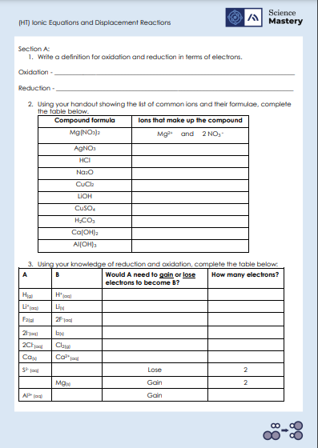
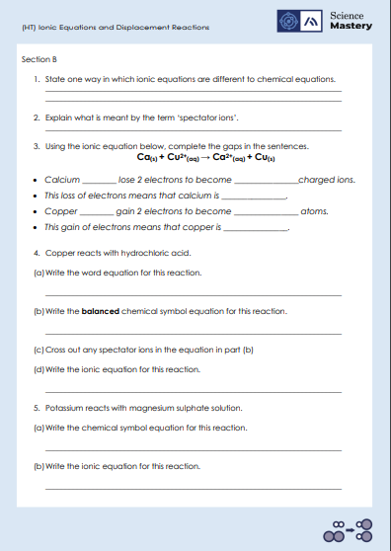
Activity
Deliberate Practice
Aim High | Work Together | Be Kind | Lead the Way

Slide 17
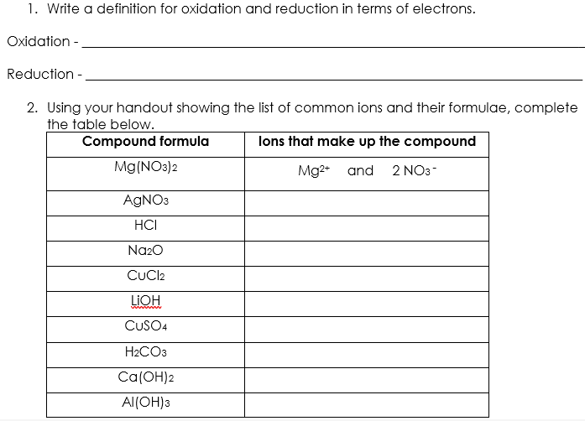
Answers – Section A
is the loss of electrons.
is the gain of electrons.
Ag⁺ and NO₃⁻
H⁺ and Cl⁻
2 Na⁺ and O²⁻
Cu²⁺ and 2 Cl⁻
Li⁺ and OH⁻
Cu²⁺ and SO₄²⁻
2 H⁺ and CO₃²⁻
Ca²⁺ and 2 OH⁻
Al³⁺ and 3 OH⁻

Slide 18
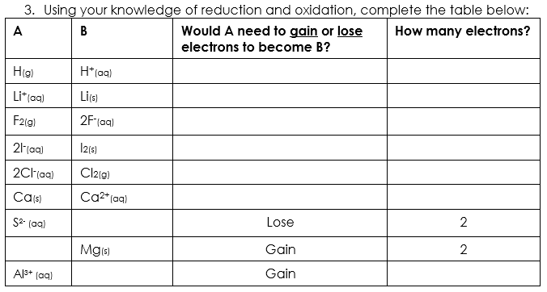
Answers – Section A
Lose
1
Gain
1
Gain
2
Lose
2
Lose
2
Lose
2
S_{(s)}
Mg²⁺_{(aq)}
Al_{(s)}
3
Notes:
Alternative answer for bottom row: could be Al²⁺ when one electron is gained, or Al⁺ when two electrons are gained.

Slide 19
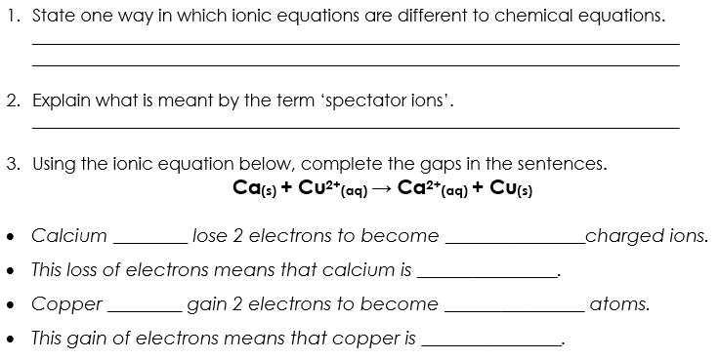
Answers – Section B
Spectator ions are removed in ionic equations but not in chemical equations. Charges on ions are shown in ionic equations but not in chemical equations.
Ions that are the same in the reactants and the products.
atoms
positively
oxidised
ions
neutral
reduced

Slide 20
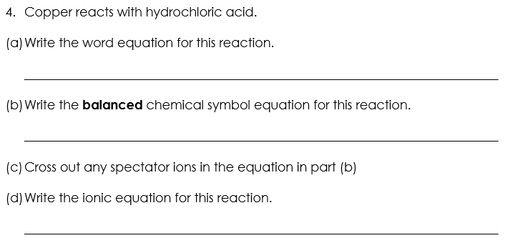
Answers – Section B
Copper + hydrochloric acid → copper chloride + hydrogen
X
X
Cu_{(s)} + 2HCl_{(aq)} → CuCl_{2 (aq)} + H_{2(g)}
Cu_{(s)} + 2H⁺_{(aq)} → Cu²⁺_{(aq)} + H_{2(g)}

Slide 21
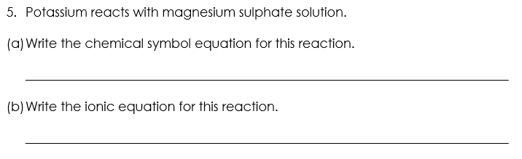
Answers – Section B
X
X
2K_{(s)} + MgSO_{4(aq)} → K₂SO_{4(aq)} + Mg_{(s)}
2K_{(s)} + Mg²⁺_{(aq)} → 2K⁺_{(aq)} + Mg_{(s)}

Slide 22
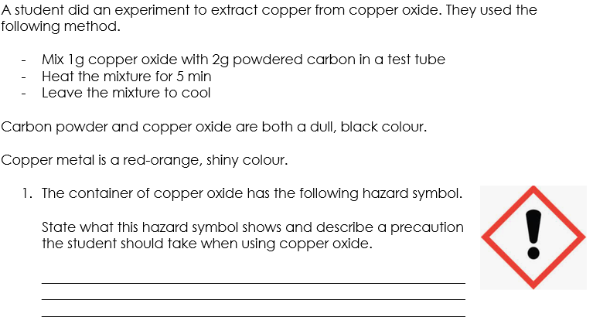
Answers – Section C
Harmful. The precautions the student should take is to wear goggles and wash hands immediately if the copper oxide touches skin.
Notes:
Alternative answers – accept any reasonable precaution that would prevent the copper oxide touching the skin or eyes.

Slide 23
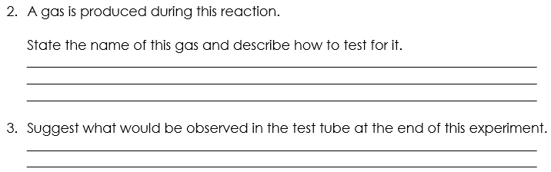
Answers – Section C
Carbon dioxide is produced. To test for the presence of carbon dioxide, the gas should be bubbled through lime water/calcium hydroxide solution, and it changes colour from clear to cloudy.
Solid copper metal, which is a red-orange shiny colour, would be observed.
Notes:
Alternative answers – accept any reasonable precaution that would prevent the copper oxide touching the skin or eyes.

Slide 24
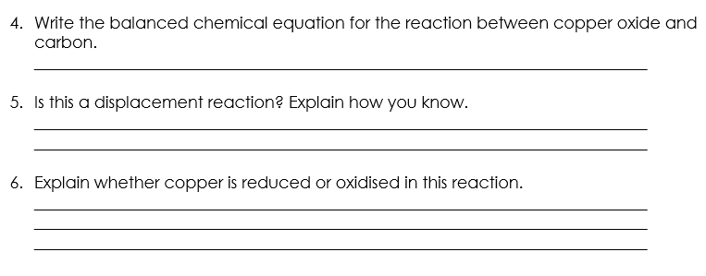
Answers – Section C
2CuO_{(s)} + C_{(s)} → 2Cu _{(s)} + CO_{2(g)}
Yes – because carbon is a more reactive element than copper, so it displaces it and reacts with oxygen.
Copper is reduced because it gains electrons. It starts as Cu²⁺ in copper oxide and then becomes neutral copper atoms.
Notes:
Alternative answers – accept any reasonable precaution that would prevent the copper oxide touching the skin or eyes.

Slide 25
Answer the questions below.
Define reduction.
A. Reduction is the loss of oxygen or the gain of electrons
B. Reduction is the loss of oxygen or the loss of electrons
C. Reduction is the gain of oxygen or the gain of electrons
D. Reduction is the gain of oxygen or the loss of electrons.
✓
2. Magnesium reacts with copper (II) sulfate in a displacement reaction. The chemical equation for this reaction is Mg(s) + CuSO₄(aq) -> MgSO₄(aq) + Cu(s). What is the ionic equation for this reaction?
A. Mg(s) + Cu²⁺⁽aq) + SO₄²⁻(aq)-> Mg²⁺⁽aq) + SO₄²⁻(aq)+ Cu(s)
B. Mg(s) + Cu²⁺⁽aq) → Mg²⁺(aq) + Cu(s)
C. 2Mg(s) + Cu²⁺⁽aq) → Mg²⁺(aq) + 2Cu(s)
✓
Notes:
Q1. Answer: A
If students answer B or D, they think that reduction is the loss of electrons. To fix-it, use OIL RIG to help students remember that oxidation is the loss of electrons and reduction is the gain of electrons.
If students answer C, they think that reduction is the gain of oxygen. They might be mis-using the OIL RIG (thinking it refers to reduction as gaining oxygen instead of reduction gaining electrons). To fix-it, remind students that the word oxidation starts with ‘ox’ because it involves the gain of oxygen.
Q2. Answer: B
If students answer A, they have successfully written each part of the chemical equation as ions, however they have forgotten to remove the species that appear on both sides of the equation (in this case the sulfate ion). To fix-it, remind students that any species that appears in exactly the same way on both sides of the equation is not included in the final ionic equation. Give students more practice in writing ionic equations.
If students answer C, they have included the correct species in their ionic equation, however they have made the common error of trying to balance this equation. Students sometimes mistakenly treat the ion charges as if they were subscript numbers or coefficients. To fix-it, remind students that the charges are not indicative of the number of ions. Give students more practice in writing ionic equations.

Slide 26
Answer the questions below.
3. Sodium atoms are sometimes oxidised to become positively charged sodium ions. Why is this an oxidation reaction?
A. Because oxygen is added to the sodium atoms
B. Because oxygen is lost from the sodium atoms
C. Because the sodium atoms lose electrons to become positively charged
D. Because the sodium atoms gain electrons to become positively charged
✓
Notes:
Q3. Answer: C
If students answer A, they are taking the term oxidation in this case to mean the addition of oxygen, and have not considered (or do not know) what oxidation means in term of electrons. To fix-it, remind students that where oxidation results in ions becoming charged, that the question is referring to the loss of electrons (and not the gain of oxygen).
If students answer B, they are taking the term oxidation in this case to mean the removal of oxygen. This means they both do not understand that oxidation is the addition of oxygen, and they have not considered that this question requires a consideration of oxidation in terms of electrons. To fix-it, remind students of the definition of oxidation in terms of oxygen, and in terms of electrons. Remind students that where oxidation results in ions becoming charged, that the question is referring to the loss of electrons.
If students answer D, they correctly recognise that the question is referring to oxidation in terms of electrons (and not in terms of the gain or loss of oxygen). However, the student thinks that gaining electrons results in a positive charge. To fix-it, remind students that electrons have a negative charge. Therefore, the gain of electrons will result in negatively charged ions.

